Slide 1
CSYE 7280 – UX Design Final Presentation
E Commerce Website (Walmart)

Slide 2
In this Presentation
Overview, Problem Statement and Solution
Product Objectives
Google Material Design
Target Audience
User Needs
Personas
Use Cases
Onboarding
Research Methods
Card Sorting
User Workflow/ Information Architecture
Prototype Error Handling
Usability Testing Objectives and Tasks
Planes
Sample Prototype
Prototype Demo

Slide 3

Overview, Problem Statement and Solution
Overview
Today's shoppers are now digital-first researching the products they want to buy online before making a purchase. From groceries and clothes to gadgets and power tools, anyone can purchase anything online.
Problem Statement
In the recent times, Walmart or other E-Commerce websites have seen a decline in the number of customers who purchase products compared to users doing a window shopping.
Problem Solution
Our aim is to understand current trends and user behavior to offer the best functionality and convert users into customers.

Slide 4
Target Audience
On a general note, everyone who is connected to technology is being targeted in e-commerce applications.
Specifically talking, the targeted audience can be:
People in age group of 15-65 years.
Who are ready to buy products online rather than going to store
Customers who need wide range of products.
Customers who require fast and reliable delivery services.

Slide 5
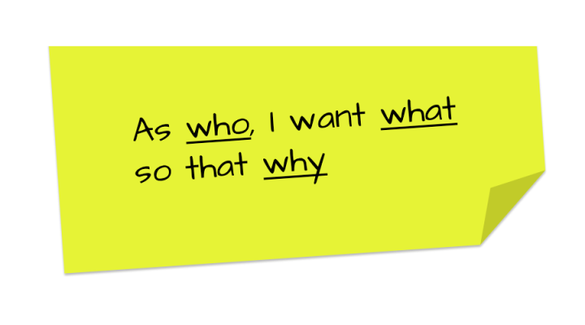
User Needs
Easy and Intuitive User Interface
Fast and Reliable Delivery
Wide range of Products and Comprehensive Menu
Convenient Payment Options
Reasonable Pricing with promotions and discounts
Customer Service and Product Tracking

Slide 6
Product Objectives
Provide a wide variety of products for customers to choose from, including popular brands and unique, niche products.
Ensure product availability and accurate inventory management to prevent overselling or stockouts.
Offer competitive pricing and promotions to attract and retain customers. Enable customers to easily find and discover products through search, recommendations, and other personalized features.
Provide detailed product information, including specifications, photos, and reviews, to help customers make informed purchase decisions.
Streamline the checkout process and provide a secure payment system to increase customer conversion rates.
Offer fast and reliable shipping options, including free shipping and expedited delivery, to meet customer expectations.
Provide high-quality customer service and support to address any issues or concerns that customers may have with their orders or products.
Encourage repeat business and customer loyalty through rewards programs, personalized offers, and other retention strategies.
Continuously evaluate and improve the product offering based on customer feedback and market trends to stay competitive and meet changing customer needs.

Slide 7
Persona 1
Persona 1: John, a working dad with a busy schedule​
Age:​ | 38​
Occupation:​ | Accountant​
Income:​ | $75,000​
Objectives:​ | John wants to save time and money while shopping for his family's groceries and household essentials.​
Previous experiences:​ | John has used Walmart's online grocery pickup service and found it convenient, but sometimes the items he receives are not exactly what he ordered.​

Slide 8
Persona 2
Persona 2: Maria, a college student on a tight budget
Age: | 21
Occupation: | Student
Income: | $15,000
Objectives: | Maria wants to buy affordable school supplies and clothes for the new semester.
Previous experiences: | Maria has shopped at Walmart before and likes the low prices, but sometimes the quality of the items is not great.

Slide 9
Persona 3
Persona 3: David, a senior citizen with limited mobility
Age: | 72
Occupation: | Retired
Income: | $30,000
Objectives: | David wants to buy groceries and household essentials without leaving his home.
Previous experiences: | David has not used Walmart's online grocery delivery service before, but he has heard good things about it from his friends.

Slide 10
Persona 4
Persona 4: Mary is a busy working mom who needs to buy groceries for her family
Age: | 35
Occupation: | Working Mom
Income: | $80,000
Objectives: | Mary is looking for a convenient and efficient way to buy groceries for her family.
Previous experiences: | Mary has tried online grocery shopping in the past but found it to be too time-consuming.

Slide 11
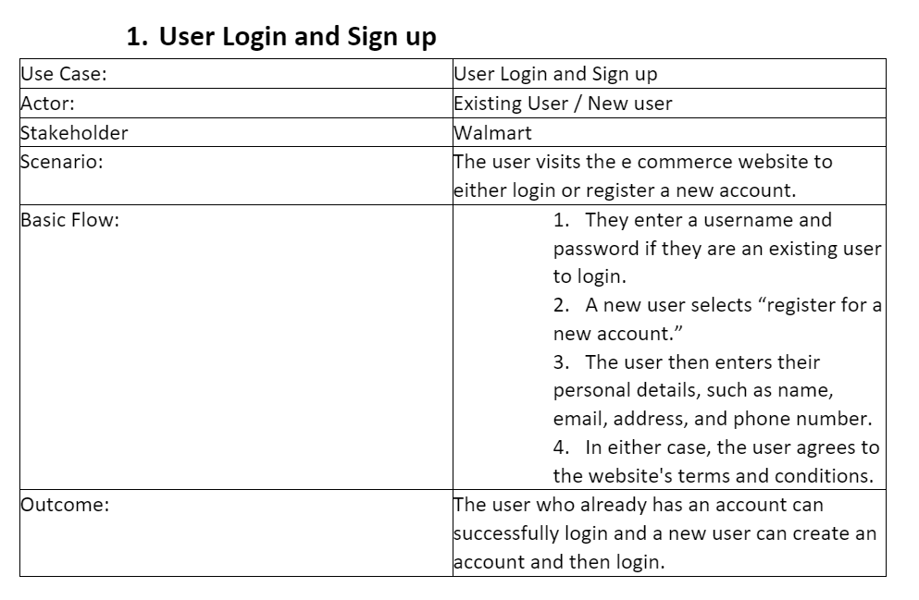
Use Cases
We have created 4 use cases which can be categorized as Basic Flow, Medium Weight Use Case, Heavy Weight Use Case.
The Use cases are:
User Login and Sign Up
Product Return and Refund
Subscription Service
Payment Service
Use Cases Document
Example of Basic Flow showing User Login and Sign Up.

Slide 12
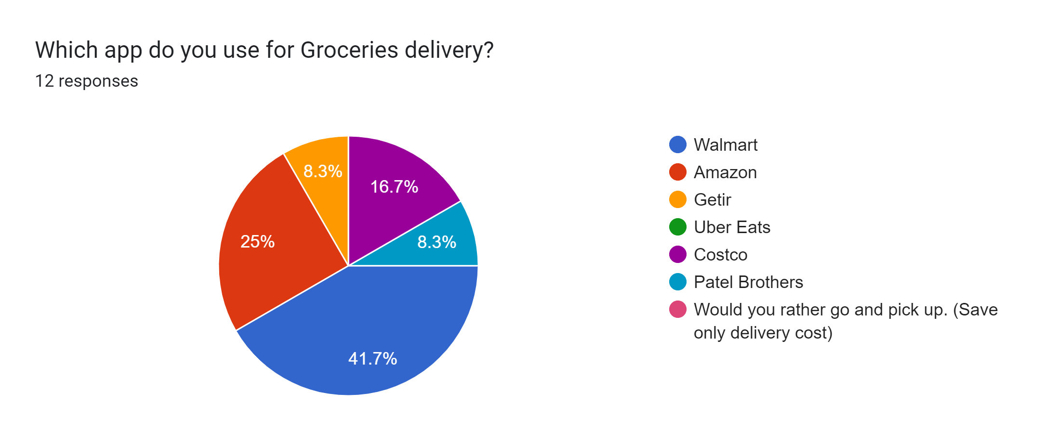
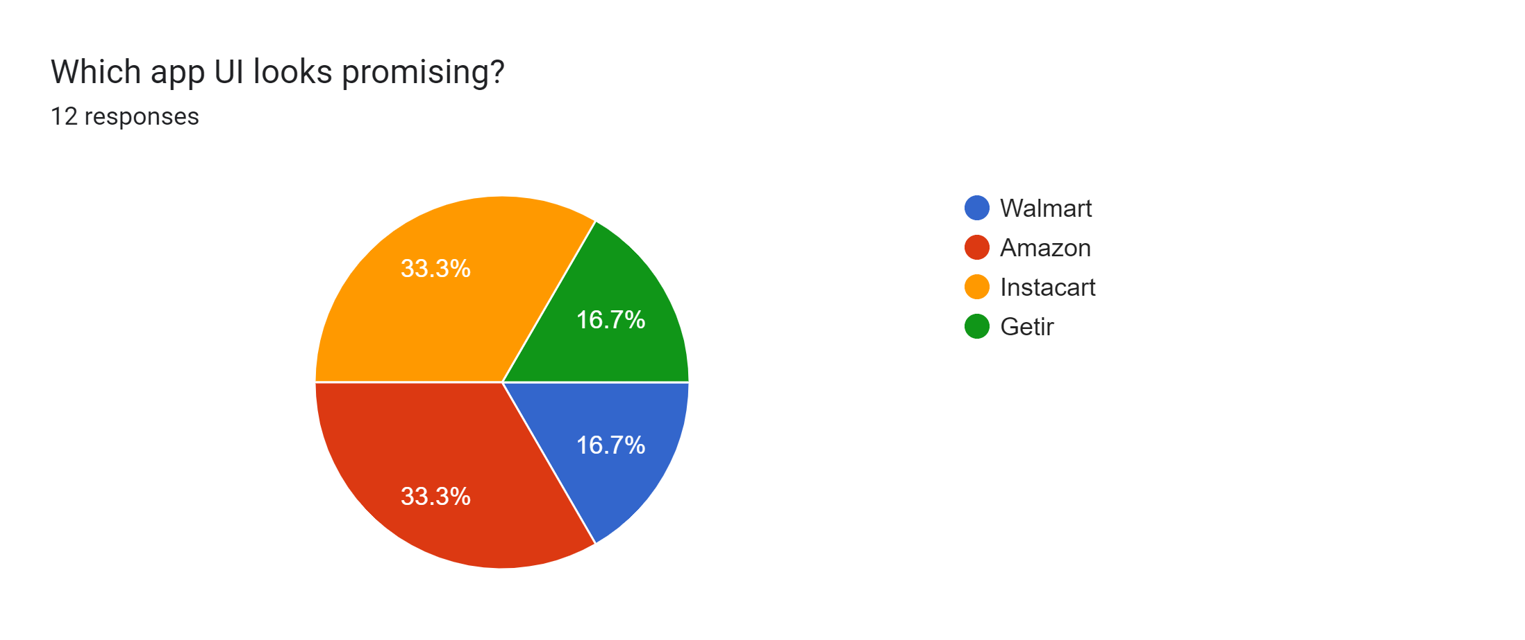
User Research Methods
User Interviews:
Conducted 1 on 1 interviews to a few regular customers to know their feedback on the effectiveness of the application.
Surveys:
Collected quantitative data of few users such as their demographics, frequency of using the app, reasons for using other e-commerce applications.
FAQ Review:
To better understand users' experiences with the site and app, we asked the most common questions users have about Walmart's mobile app.
User Research Methods Document

Slide 13
Usability Testing
Objectives
Evaluate the overall usability of the Walmart application
Identify any usability issues that may prevent users from completing their tasks efficiently
Assess the ease of use of key features, such as search, browsing, checkout, and account management
Determine user satisfaction with the application and likelihood to recommend it to others
Tasks
Find a specific product on the Walmart application using the search function
Browse through different product categories and subcategories to find a desired item
Add an item to the shopping cart and proceed to checkout
Create an account on the Walmart application and manage personal information
Search for a local Walmart store and obtain store hours and location
Use the "scan and go" feature to purchase items in-store using the Walmart application
Provide feedback on the overall user experience and any areas for improvement

Slide 14
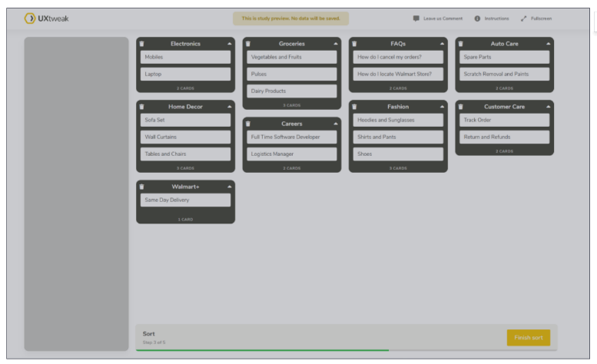
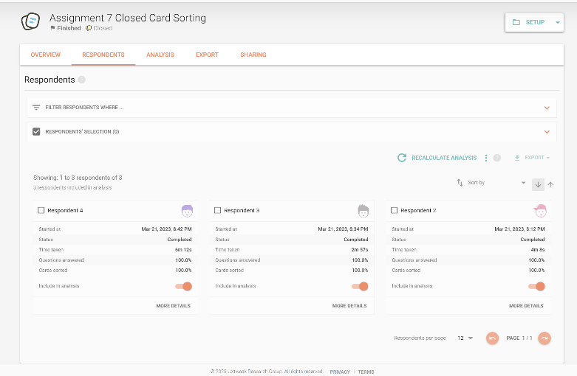
Closed Card Sorting
We considered 3 users to arrange the cards according to preset categories using labels made we have created. Information must only be aligned with pre-existing categories for the participants.
Card Sorting Document

Slide 15
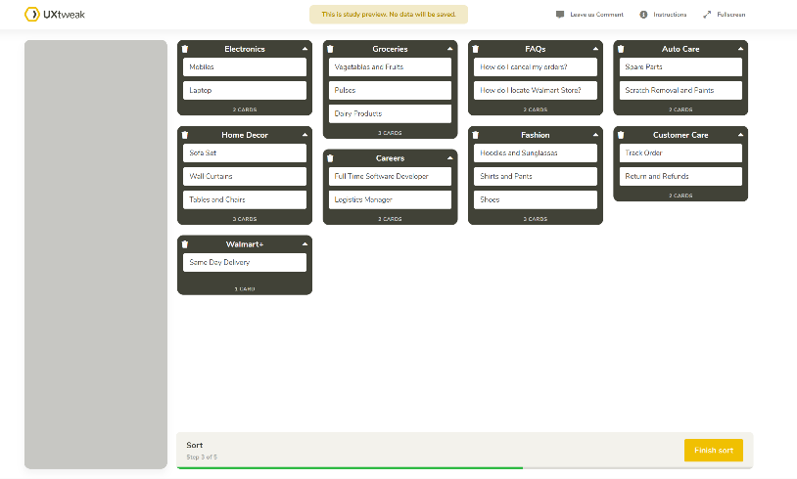
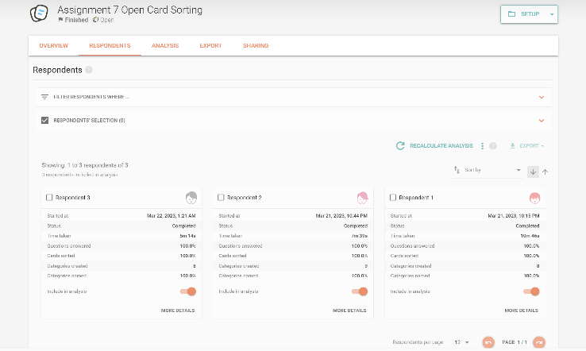
Open Card Sorting
We considered 3 users to arrange the cards according to their own categories using any labels that are created by the users itself. Users can identify the labels without any restrictions
Card Sorting Document

Slide 16
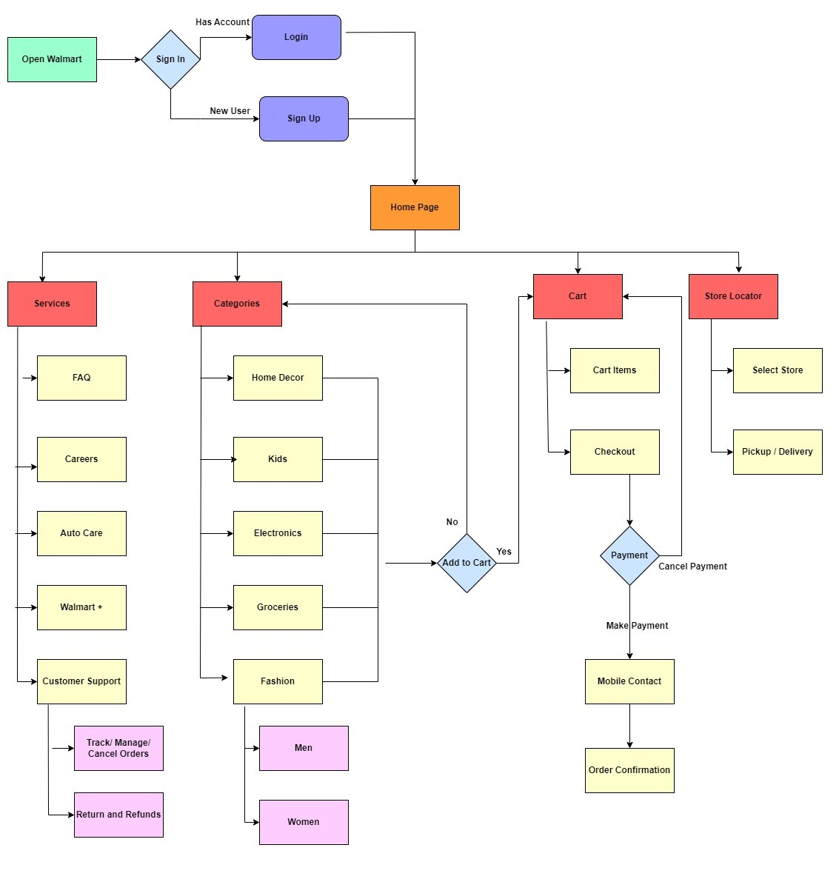
Closed Card Sorting Information Architecture
The closed card Information Architecture was designed based on the responses of the 3 users for the preset categories.
The users will not have an option to create a new label to organize the categories

Slide 17
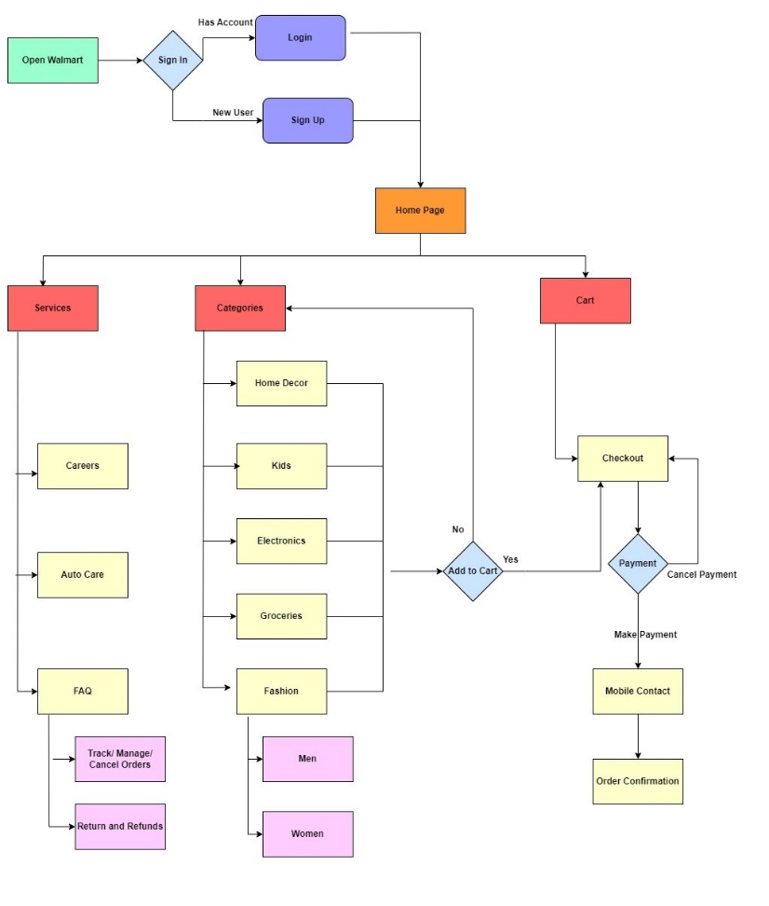
Open Card Sorting Information Architecture
The open card Information Architecture was designed based on the responses of the 3 users.
Similar kind of labels under the categories were grouped in generalized manner to accommodate all the user responses.

Slide 18
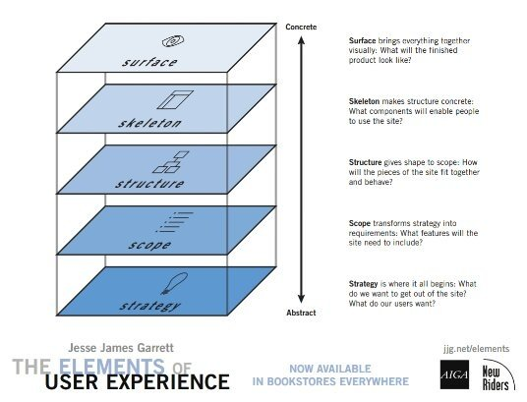
Structure Plane
Making information easy to understand and making the app self-explanatory.
Ensuring smooth animations and presenting the right amount of information.
Using pop-ups for common actions such as filtering and sorting to reduce page navigation.

Slide 19
Skeleton Plane
Defining the UI look and feel, including choosing colors, fonts, and font sizes.
Determining the number of pages and navigations required for each action.
Developing brand identity, including creating a logo, selecting primary color (red), primary background color (dark grey), and primary text color (white).
Using light green for secure actions, gray for neutral actions, red for important actions, and blue for important links.

Slide 20
Surface Plane
Maintaining consistency in background and text colors across all pages.
Consistently using pop-ups to perform smaller actions to avoid frequent page switching.
Ensuring all pop-ups have two ways to close them.
Using bright black, green, red, and gray colors to provide a rich and modern UI experience.

Slide 21
Scope Plane
It covers the strategies recoverd to make the business a success by including the most important features.
Defining the features of the app, target audience, requriement, requirements gathering using MoSCoW approach.

Slide 22
Strategy Plane
It talks about what the users need from the website and how the designers can implement it.
What do we want get out of the application and what the users want.

Slide 23
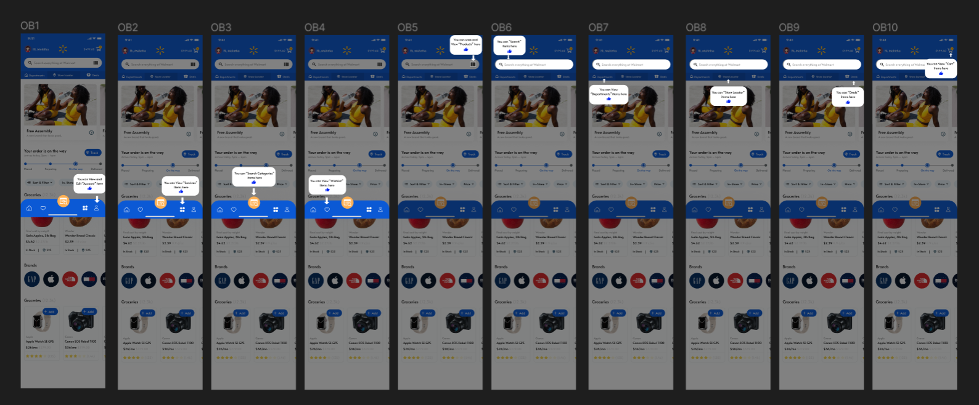
Onboarding
We have created a virtual text and sign board onboarding for new users who are not accustomed by the Walmart Application and for new users.

Slide 24
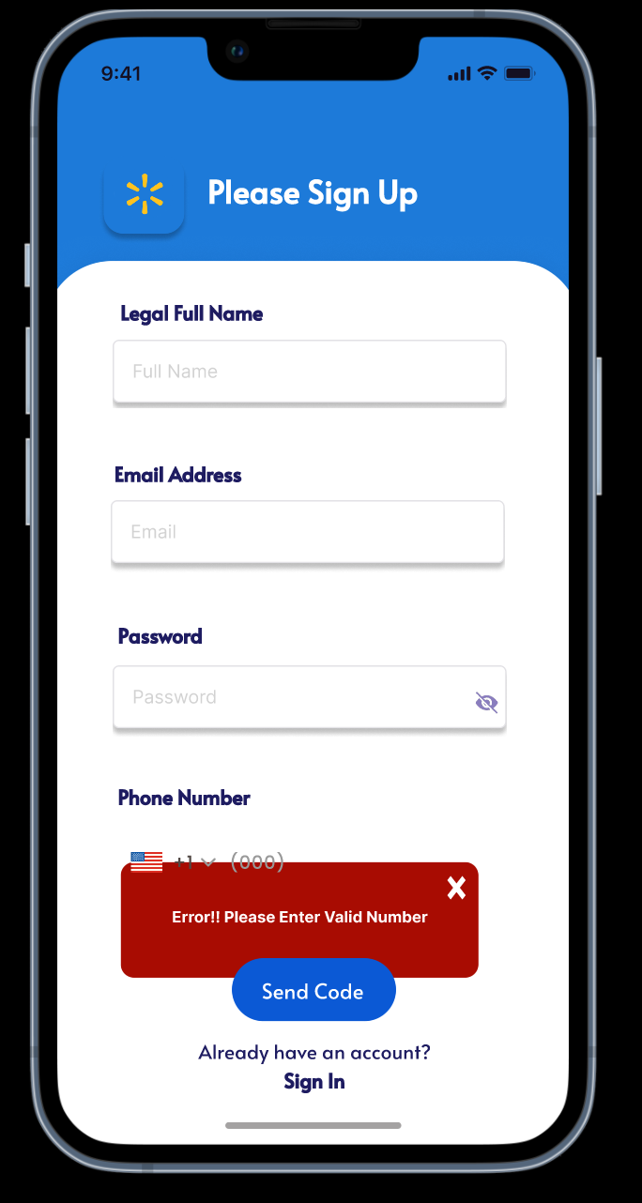
Prototype Error Handling
We have added few error handling and validation wherever required.
For Example, in the sign-up page a phone number cannot have an alphabet, so if the users enter an alphabet, they are shown an error message

Slide 25
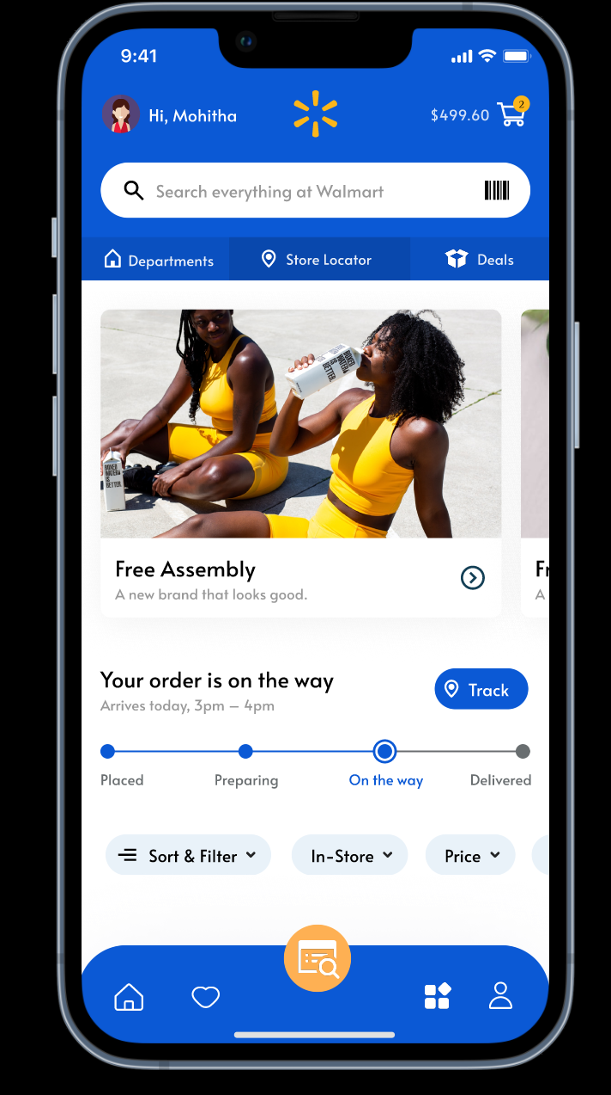
Sample Prototype
A sample image of the prototype home screen that has been developed.
Compared to the previous design, we have implemented few additional features:
Implemented mobile app instead of website.
Added Scanner to scan the products.
Face recognition to confirm the payment.
Added vouchers, Walmart loyalty points and rate the app experience.

Slide 26

Google Material Design
Colors
White – For the panel background, text on buttons
Blue – For the panels, logo and button background
Shapes
Rectangle – For Frames, Components, text fields
Rounded Rectangle – For all the buttons
Properties
Dimension – 390 x 844
Black – Text field inside the application
Meaningful Material Colors – Blue and White
Font –Inter, Alata, Poppins
Navigation – Forward and Lateral
Iconography – Icons and Vectors and Images from Google.
Plugins – Material Design Icons, Icon8, Illustrations, Iconduck
Color Palette Used

Slide 27





Thank You… !!!
Group 1 Members
Name : Aditya Kanala NUID : 002914764
Name : Mohitha Edara NUID : 002770011
Name : Rutvik Garlapati NUID : 002727922
Name : Anshul Singh NUID : 002747160
Name : Pramod Begur Nagaraj NUID : 002708842

